Slide 1
Employee Attrition Prediction
Presented By:
Nikhil Agrawal (Team Leader)
Ansh Dubey
Rohit Choudhary
Govind Upadhyay
Vikas Kumar

Slide 2
Table of Contents
Introduction
Types of Attrition
Factors of Attrition
Dataset Overview
Data Pre-processing
Exploratory Data Analysis
Predictive models
Model Training, Testing and Validation
Model Results and comparison
Feature Importance
Demonstration
Conclusion
Reference and Tools
Question & Answers

Slide 3
Hook Story

Slide 4
Introduction
Definition: Attrition refers to the normal phenomenon of the employees leaving the company/organization (voluntarily or involuntary) due to reasons which can be professional or personal pertaining to the company's environment and culture.
Importance:
High attrition is a cause of concern for a company as it presents a cost to the company.
The company also have to spend additional money to fill the vacancies left open by these employees.
Formulae
Attrition Rate (%)= (Number of separations/ Average Number of employees) * 100

Slide 5
Types of Attrition
Voluntary Attrition: When an employee leaves the company for a better job opportunity or career growth or more pay, and leaves on his own.
Involuntary Attrition: If an employee is terminated from a job due to some issue like lack of performance. Sometimes, a degrowing business also forces employees to quit the job, which leads to a higher rate of people leaving.
Retirement Attrition: Once an employee finishes his/her tenure at a company and retires. This is mostly a natural attrition that occurs and companies are prepared with succession planning.

Slide 6
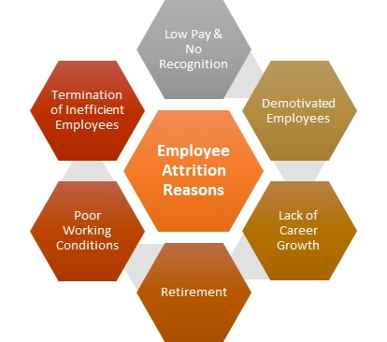
Factors of Attrition
Better pay & job opportunities outside the organization.
Low Pay or no recognition of employees
Improper work life balance can cause a high attrition rate.
Inadequate and poor working conditions leading to lack of motivation.
Retirement or death of employees when at job.

Slide 7
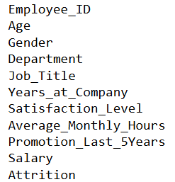
Dataset Overview
Employee & Demographics
Employment History
Performance and Engagement
Compensation and Benefits
Work Environment
Company-Related Factors

Slide 8
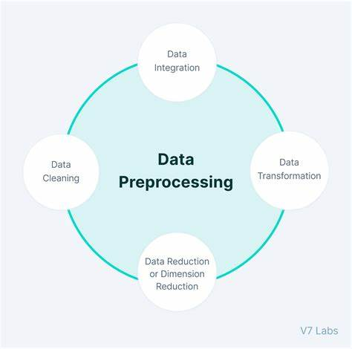
Data pre-processing
Noise Reduction
Handling Categorical Data
Normalization of Data
Dimensionality Reduction

Slide 9
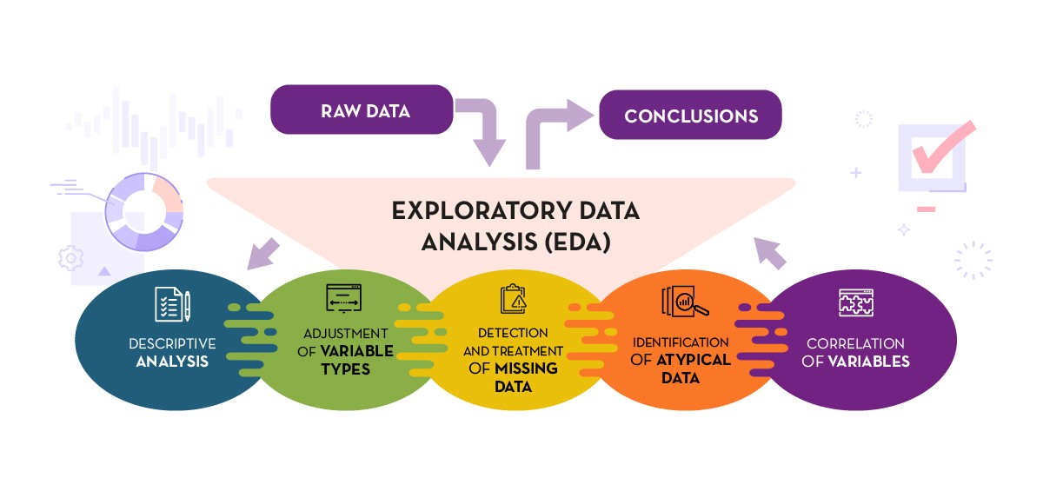
Exploratory Data Analysis

Slide 10
Predictive models
Random Forest: An ensemble learning method that builds multiple decision trees and averages their predictions. It’s more robust than a single decision tree and reduces overfitting.
Support Vector Machines (SVM): A powerful algorithm that can handle both linear and non-linear classification by finding a hyperplane that separates the classes.

Slide 11
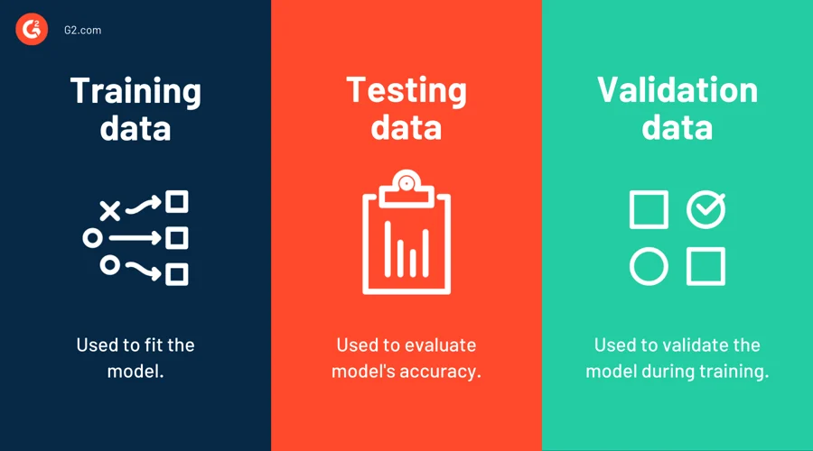
Model Training, Testing and Validation

Slide 12
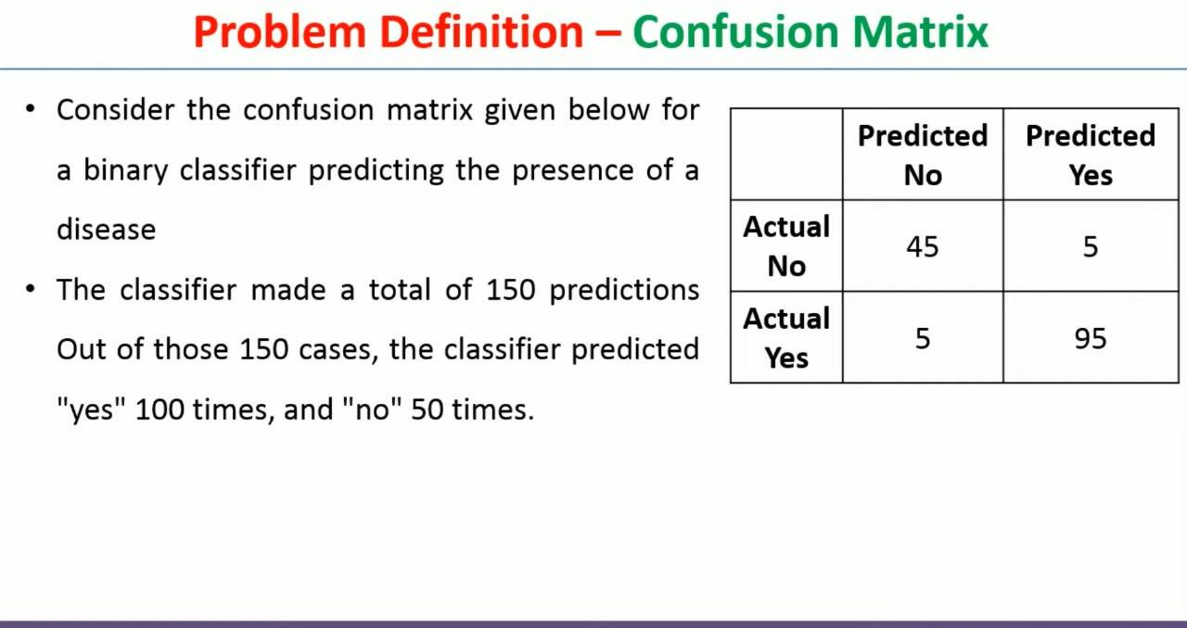
Model Results and comparison

Slide 13
Feature Importance
Definition: Features in machine learning, also known as variables or attributes, are individual measurable properties or characteristics of the phenomena being observed.
Importance:
Enhanced Model Performance
Faster Training Times
Reduced Overfitting

Slide 14
Demonstration

Slide 15
Conclusion
Building a predictive model for employee attrition can provide actionable insights into the factors influencing turnover and help HR departments develop targeted retention strategies. By carefully selecting the right model, preprocessing the data, and validating the results, organizations can identify employees at risk of leaving and take preventive measures to reduce attrition.

Slide 16
References and Tools
References
Tools
YouTube
Kaggle
Google
Colab Notebook
Vs Code
Google Crawler

Slide 17
Question & Answers

Slide 18
Thank You

